Slide 1

Columbia Fintech bootcamp project 2 – Algorithmic trading Strategy
JEFF smith, Mike cutno, Russell moore, sheng gao

Slide 2
Executive summary
Sentimental intraday algorithmic trading program made on paper trading account held with Alpaca Markets Brokerage
By following the news both live on television and on financial website, we could quickly enter the market and earn gains by buying and shorting the securities and exit the positions quickly – Jeff
Adopt a sentimental machine learning algorithm to interpret the headlines as either positive or negative for the Nasdaq, which allows us to trade theoretically based on the machine learning signals – Russell, Sheng
Use technical indicators to sell the securities or alert us to potentially exit the position – Mike

Slide 3
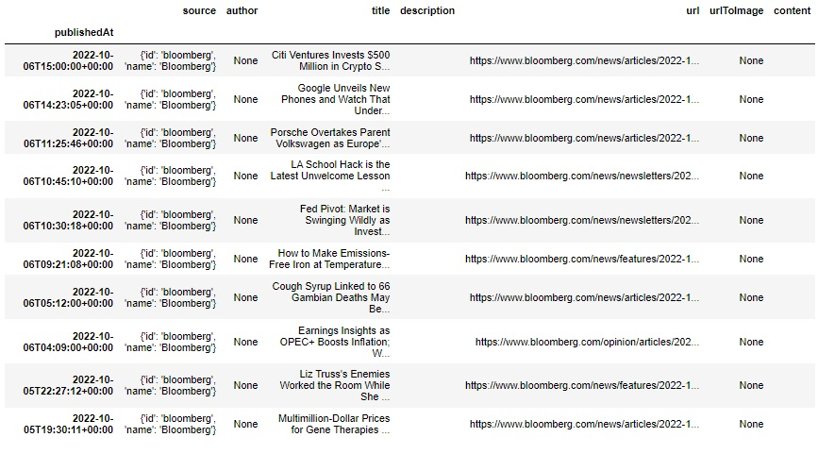
Sentimental analysis
Alpaca News API
Marketaux
News API

Slide 4
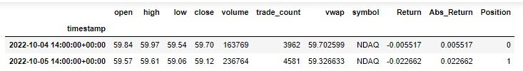
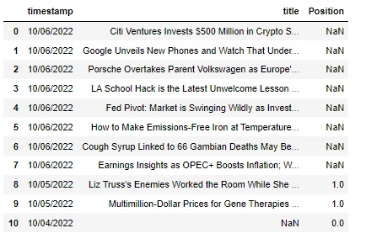
Sentimental analysis: data prep
Format Discrepancy
Merging
NLP Cleanup

Slide 5
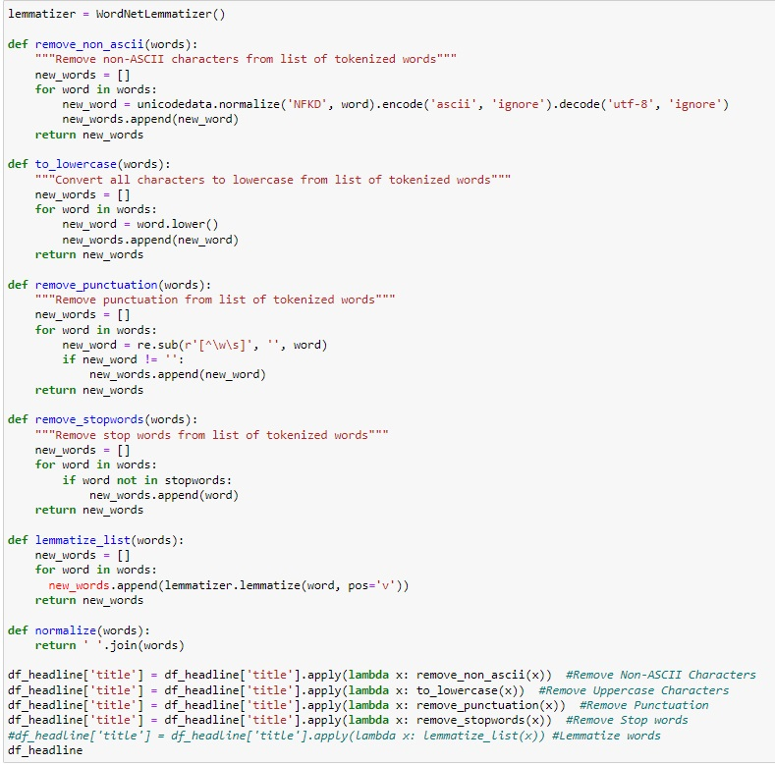
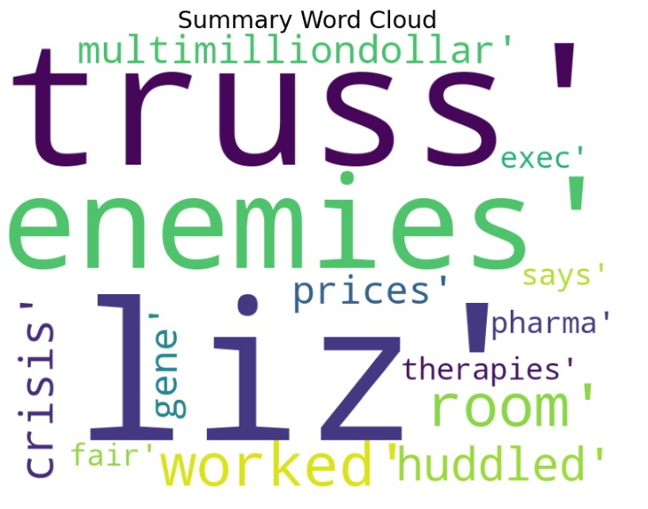
Sentimental Analysis: NLP

Slide 6
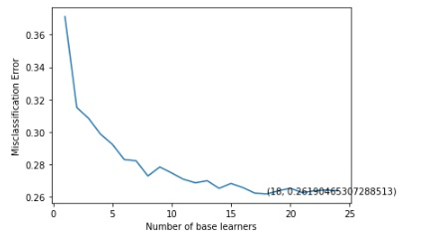
Sentimental analysis: Random forest
K-folds cross validation
Estimators for Random Forest
Confusion Matrix
Term Frequency (TF)
Inverse Document Frequency (IDF)

Slide 7
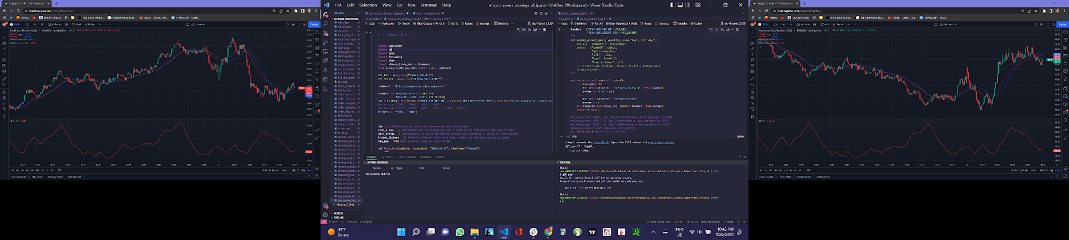
Our approach
Currently, we look at the market and decide when to run our quant below. In the future, we may be able to run our machine learning algorithm to start the trades and exit based on the technical indicators.

Slide 8
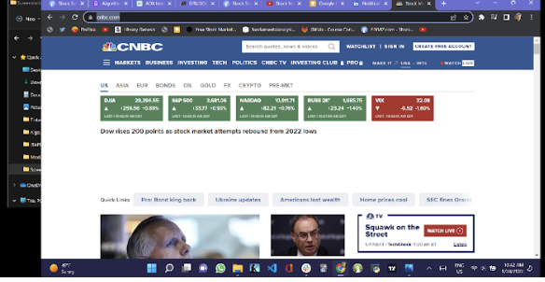
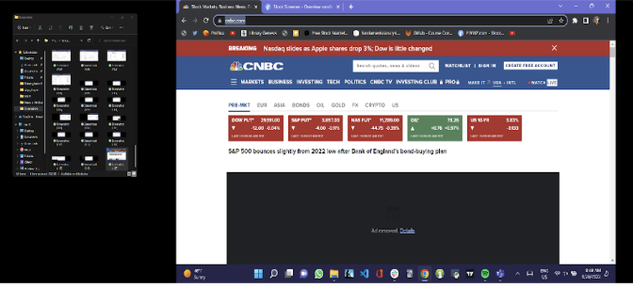
How does the market feel? Look at the news!
Markets feeling good? We’re in!
Markets feeling bad? We’re in!

Slide 9
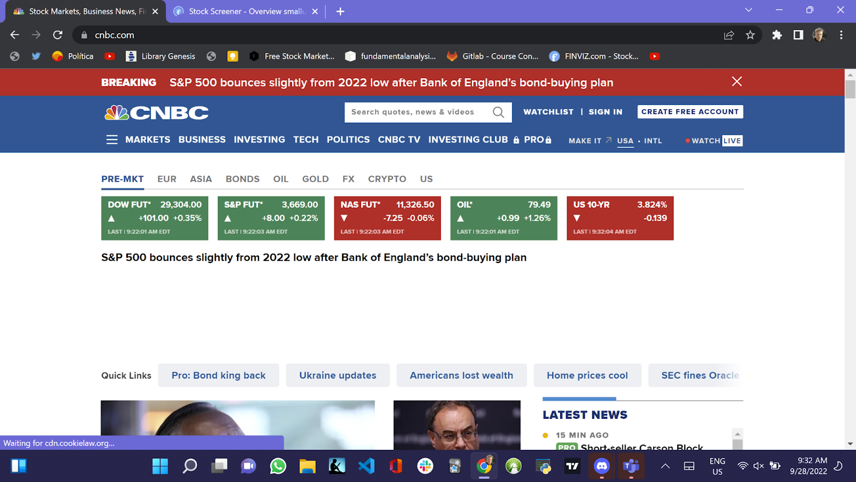
How does the market feel? Look at the news!
The market is undecided about what it will do. I am out!!

Slide 10
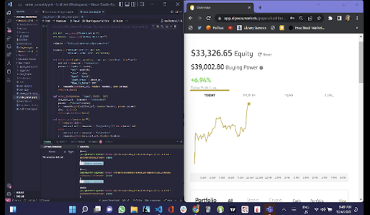
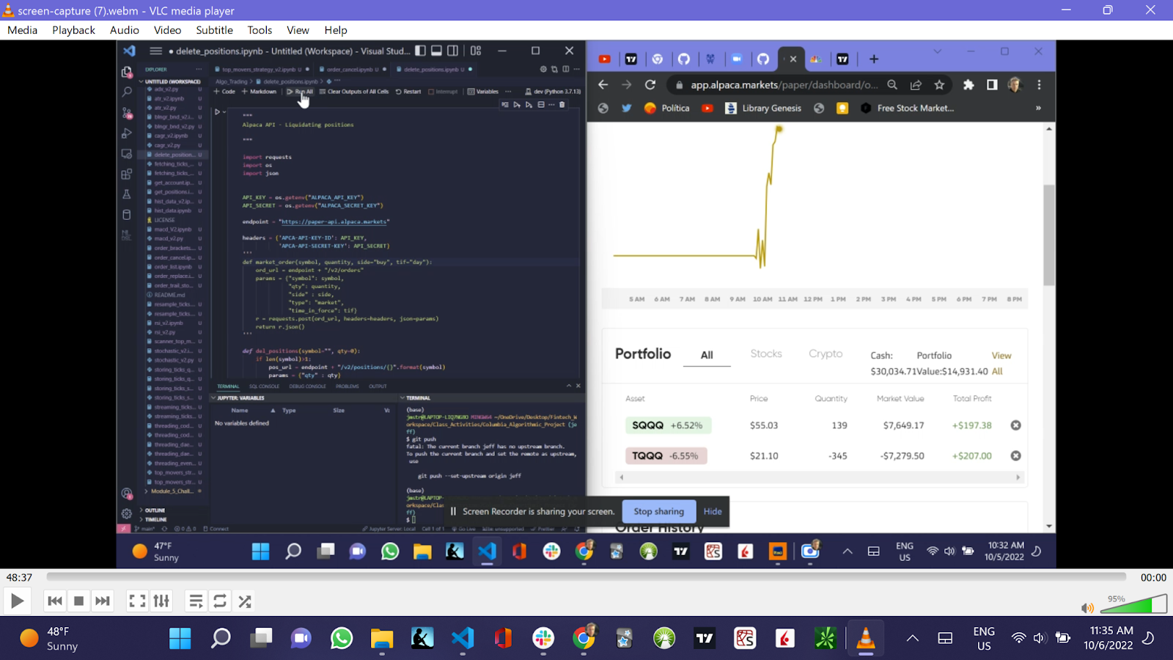
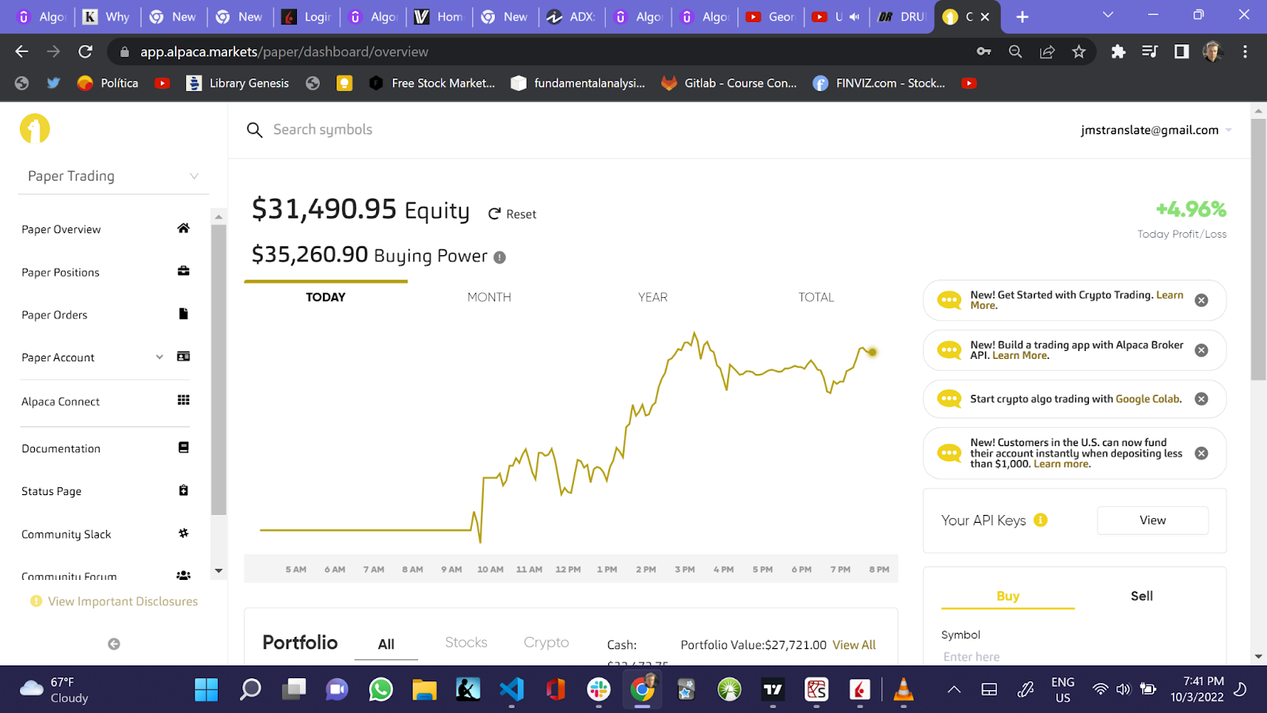
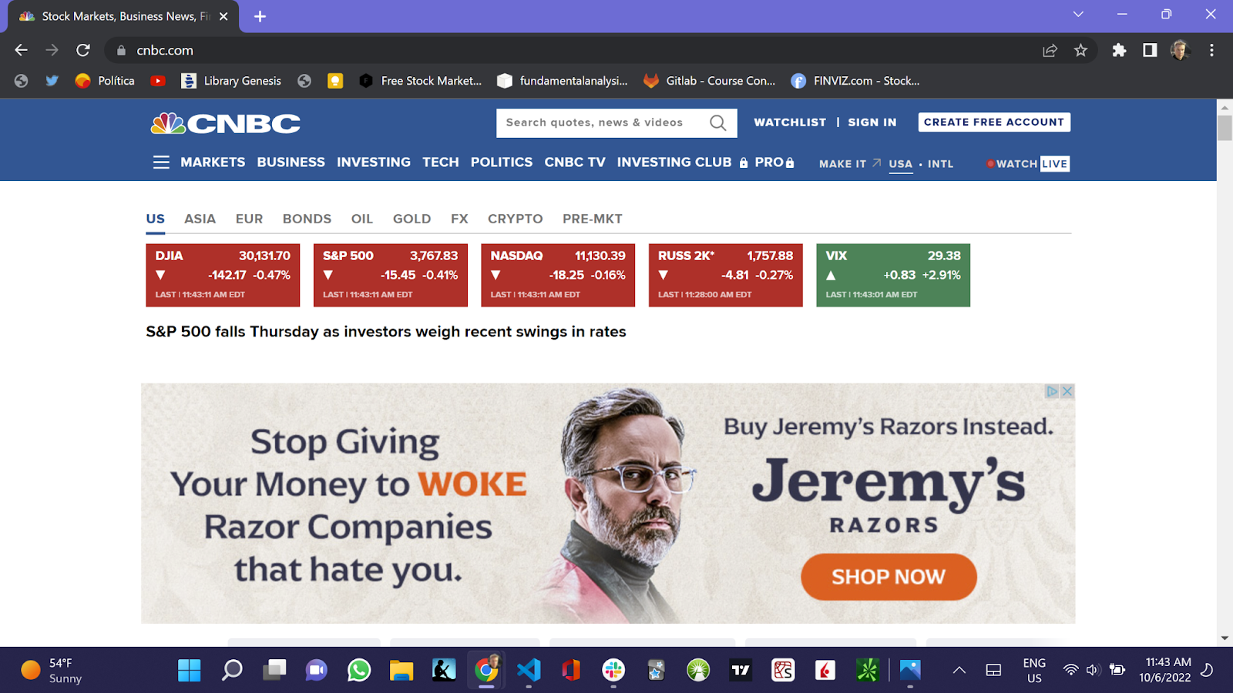
Our returns $$$
Monday
Tuesday
Wednesday
Thursday

Slide 11

Thank you! let’s trade and make money$$$

